Slide 1


Continuity in development of scope ambiguity resolution and the importance of numeral semantics
Presented by K.J. Savinelli
Work with Gregory Scontras and Lisa Pearl
10/22/2017

Slide 2
Development and Ambiguity Resolution
The pragmatics of ambiguity resolution matters all the time.
Notes:
Overcoming ambiguity and vagueness. . . Write out words instead of this dumb image. Save time. . Delete all text I don’t read.

Slide 3
Development and Ambiguity Resolution
The pragmatics of ambiguity resolution matters all the time.
A: “Call me a cab.
B: “Okay, you’re a cab.”
Notes:
Overcoming ambiguity and vagueness. . . Write out words instead of this dumb image. Save time. . Delete all text I don’t read.

Slide 4
Development and Ambiguity Resolution
The pragmatics of ambiguity resolution matters all the time.
A: “Call me a cab.
B: “Okay, you’re a cab.”
How do children figure it out?
Notes:
Overcoming ambiguity and vagueness. . . Write out words instead of this dumb image. Save time. . Delete all text I don’t read.

Slide 5
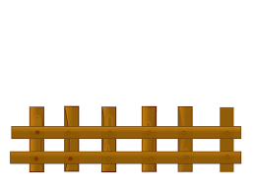
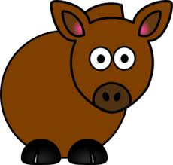
“Every horse didn’t jump over the fence”
Notes:
Make sure to narrate the animation, and have text show up after animation.

Slide 6




“Every horse didn’t jump over the fence”
Adults - they endorse the utterance
5-year-olds - they don’t endorse the utterance
(Musolino and Lidz, 2006; Viau et. al. 2010)
Notes:
Naïve adults. . Don’t need those faces since I have the animation.

Slide 7
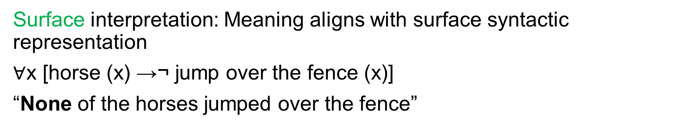
“Every horse didn’t jump over the fence”
Aka “Every-not”
Surface interpretation: Meaning aligns with surface syntactic representation
$∀$x [horse (x) →¬ jump over the fence (x)]
“None of the horses jumped over the fence”

Slide 8
“Every horse didn’t jump over the fence”
Aka “Every-not”
Surface interpretation: Meaning aligns with surface syntactic representation
$∀$x [horse (x) →¬ jump over the fence (x)]
“None of the horses jumped over the fence”
False

Slide 9
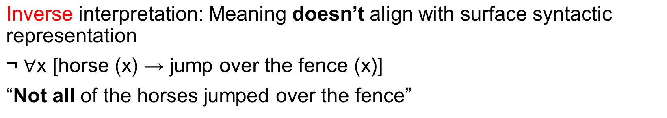
“Every horse didn’t jump over the fence”
Aka “Every-not”

Slide 10
“Every horse didn’t jump over the fence”
Aka “Every-not”
True

Slide 11
Endorsement
Adults endorse ~100%
Children endorse ~15%
“Every horse didn’t jump over the fence”
Aka ”every-not”
Inverse is true in context
Surface is false in context
Notes:
Might be the case that adults are interpreting the utterance as inverse, whereas the children are interpreting it as surface

Slide 12
Endorsement
Adults endorse ~100%
Children endorse ~15%
“Every horse didn’t jump over the fence”
Aka ”every-not”
Inverse is true in context
Surface is false in context
But wait. . .
Notes:
Might be the case that adults are interpreting the utterance as inverse, whereas the children are interpreting it as surface

Slide 13
“Every horse jumped over the log, but every horse didn’t jump over the fence”
Children:
Baseline: 15% Explicit contrast: 60%
(Musolino and Lidz, 2006; Viau et. al. 2010)

Slide 14
“Every horse jumped over the log, but every horse didn’t jump over the fence”
(Musolino and Lidz, 2006; Viau et. al. 2010)

Slide 15
“Every horse jumped over the log, but every horse didn’t jump over the fence”
You can get this (roughly) same effect without the explicit contrast:
Changing the story in the task (example: having the horses succeed at jumping over a log in the story)
By having unambiguous inverse-meaning trials before the scope ambiguity trials
  “Not every horse jumped over the fence.”
What do these manipulations do?
(Musolino and Lidz, 2006; Viau et. al. 2010)

Slide 16
Pragmatic factors:
(1) The contrast changes the children’s beliefs about the world state – base rate probability of a horse successfully jumping
(2) The contrast changes the children’s inference about the question under discussion (QUD)
Processing factors:
(3) The contrast makes it easier to access the inverse scope interpretation
What do these manipulations do?

Slide 17

We use a Rational Speech Act model to understand the disambiguation at a computational level
(Goodman and Frank, 2016)

Slide 18
We use a Rational Speech Act model to understand the disambiguation at a computational level
Bayesian modeling framework that treats language understanding as a recursive social reasoning
(Goodman and Frank, 2016)

Slide 19
We use a Rational Speech Act model to understand the disambiguation at a computational level
Bayesian modeling framework that treats language understanding as a recursive social reasoning
A listener and a speaker recursively reason about the other’s process in order to interpret utterances (listener) or make utterances (speaker)
(Goodman and Frank, 2016)

Slide 20
Reminder: we are trying to model children’s endorsement behavior
(Goodman and Frank, 2016)

Slide 21
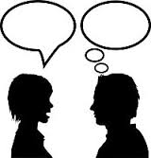

w = world state
u = utterance
i = scope
q = QUD
(Savinelli, Scontras & Pearl, 2017)

Slide 22
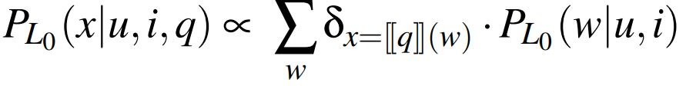
w = world state
u = utterance
i = scope
q = QUD
Literal listener
(Savinelli, Scontras & Pearl, 2017)

Slide 23

0, 1, 2, or 3
w = world state
u = utterance
i = scope
q = QUD
Literal listener
(Savinelli, Scontras & Pearl, 2017)

Slide 24
[[amb]]
“Every horse didn’t jump over the fence.”
VS
[[null]]
Nothing
w = world state
u = utterance
i = scope
q = QUD
Literal listener
(Savinelli, Scontras & Pearl, 2017)

Slide 25
Surface: “None of the Horses Jumped over the fence”
VS
Inverse: “Not all of the horses jumped over the fence”
w = world state
u = utterance
i = scope
q = QUD
Literal listener
(Savinelli, Scontras & Pearl, 2017)

Slide 26
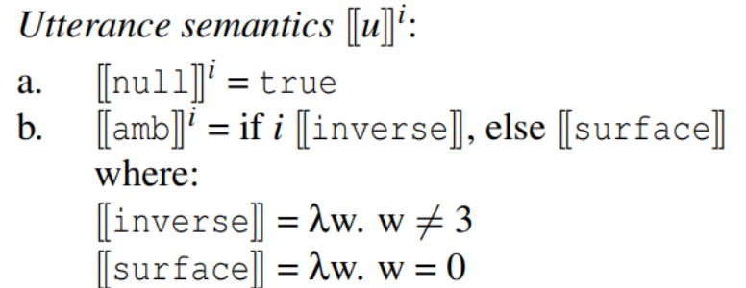
w = world state
u = utterance
i = scope
q = QUD
Literal listener
(Savinelli, Scontras & Pearl, 2017)

Slide 27
Did all the horses make it?
Did none of the horses make it?
How many horses made it?
w = world state
u = utterance
i = scope
q = QUD
Literal listener
(Savinelli, Scontras & Pearl, 2017)

Slide 28
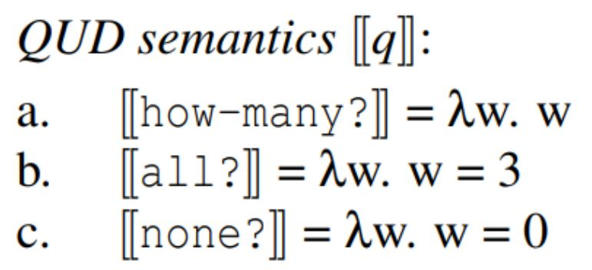
w = world state
u = utterance
i = scope
q = QUD
Literal listener
(Savinelli, Scontras & Pearl, 2017)

Slide 29

Semantics
w = world state
u = utterance
i = scope
q = QUD
Literal listener
(Savinelli, Scontras & Pearl, 2017)

Slide 30
Semantics
Prior on world state
w = world state
u = utterance
i = scope
q = QUD
Literal listener
(Savinelli, Scontras & Pearl, 2017)

Slide 31
u
The first speaker selects an utterance using a parameterized soft-max decision rule, given the semantics of the speaker
Speaker one
w = world state
u = utterance
i = scope
q = QUD
(Savinelli, Scontras & Pearl, 2017)

Slide 32
w,i,q
Inverting the speaker model, to draw a joint distribution over the uncertain factors
Pragmatic listener
w = world state
u = utterance
i = scope
q = QUD
(Savinelli, Scontras & Pearl, 2017)

Slide 33
w,i,q
Priors on factors
Pragmatic listener
w = world state
u = utterance
i = scope
q = QUD
(Savinelli, Scontras & Pearl, 2017)

Slide 34
w,i,q
Systematically manipulate the value of these priors to see how they impact the interpretation of the scopally ambiguous utterance
Priors on factors
Pragmatic listener
w = world state
u = utterance
i = scope
q = QUD
(Savinelli, Scontras & Pearl, 2017)

Slide 35
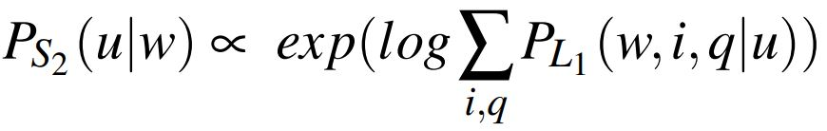
Given a specific world state, how would a pragmatic speaker want to describe that world state, reasoning about the pragmatic listener. A measure of endorsement probability
u
Speaker two
w = world state
u = utterance
i = scope
q = QUD
(Savinelli, Scontras & Pearl, 2017)

Slide 36
Results – Savinelli, Scontras, Pearl 2017
The model demonstrated that the pragmatic factors (the prior on world state and QUD) impacted the endorsement probability more than the processing factor, scope.

Slide 37
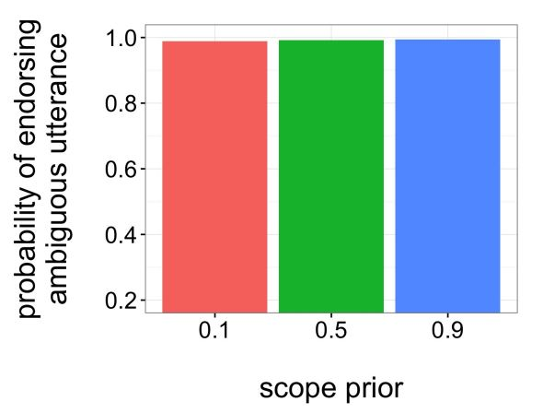
Results – Savinelli, Scontras, Pearl 2017
The model demonstrated that the pragmatic factors (the prior on world state and QUD) impacted the endorsement probability more than the processing factor, scope.
inverse

Slide 38
Results – Savinelli, Scontras, Pearl 2017
The model demonstrated that the pragmatic factors (the prior on world state and QUD) impacted the endorsement probability more than the processing factor, scope.
Probability of 3 horses succeeding is high
The QUD is favored to be all?
inverse

Slide 39
Results – Savinelli, Scontras, Pearl 2017
What does this mean? The informativity of the ambiguous utterance matters:
- correct unlikely world state beliefs
- better answer QUD
Probability of 3 horses succeeding is high
The QUD is favored to be all?
inverse

Slide 40
The Development Question
We want to know how children come to interpret these scopally ambiguous utterances like adults do.
Is there developmental continuity with respect to this disambiguation, or is there a qualitative shift in how these utterances are interpreted?

Slide 41
The Development Question
Do adults ever behave like children?
- yes!
If adults struggle the same way for the same reason, would indicate if the shift to adulthood has continuity or not.

Slide 42
Musolino and Lidz (2003) showed that adults also struggle to access the inverse scope in certain contexts.

Slide 43

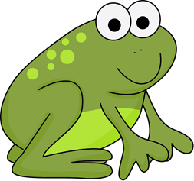
“Two frogs didn’t jump over the rock”
(Musolino and Lidz, 2003)

Slide 44
“Two frogs didn’t jump over the rock”
Adults say the speaker is wrong – they don’t endorse the utterance (adults endorsement rate = 27.5%)
(Musolino and Lidz, 2003)

Slide 45
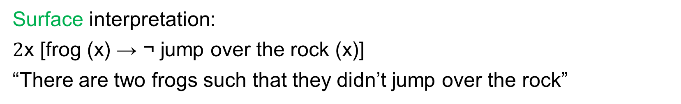
“Two frogs didn’t jump over the rock”
Aka “two-not”
Surface interpretation:
$2$x [frog (x) → ¬ jump over the rock (x)]
“There are two frogs such that they didn’t jump over the rock”

Slide 46
“Two frogs didn’t jump over the rock”
Aka “two-not”
Surface interpretation:
$2$x [frog (x) → ¬ jump over the rock (x)]
“There are two frogs such that they didn’t jump over the rock”
False

Slide 47
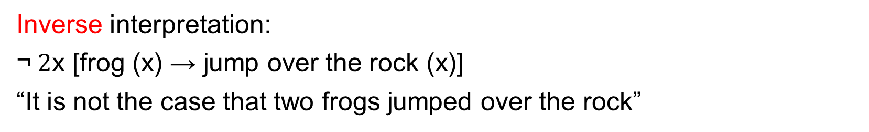
“Two frogs didn’t jump over the rock”
Aka “two-not”
Inverse interpretation:
$\text{¬} 2$x [frog (x) → jump over the rock (x)]
“It is not the case that two frogs jumped over the rock”

Slide 48
“Two frogs didn’t jump over the rock”
Aka “two-not”
Inverse interpretation:
$\text{¬} 2$x [frog (x) → jump over the rock (x)]
“It is not the case that two frogs jumped over the rock”
True

Slide 49
“Two frogs didn’t jump over the rock”
(Musolino and Lidz, 2003)

Slide 50
“Two frogs didn’t jump over the rock”
Adults now say the speaker is right– they endorse the utterance (adults endorsement rate = 100%)
(Musolino and Lidz, 2003)

Slide 51
“Two frogs didn’t jump over the rock”
Surface interpretation: True
“There are two frogs such that they didn’t jump over the rock”
(Musolino and Lidz, 2003)

Slide 52
“Two frogs didn’t jump over the rock”
Inverse interpretation: False
“It is not the case that two frogs jumped over the rock”
(Musolino and Lidz, 2003)

Slide 53
2-Frog vs 4-Frog – Why the difference?
Musolino and Lidz’s answer: adult preference for the surface scope

Slide 54
2-Frog vs 4-Frog – Why the difference?
Musolino and Lidz’s answer: adult preference for the surface scope
Inverse = False
Inverse = True
Surface = True
Surface = False

Slide 55
2-Frog vs 4-Frog – Why the difference?
Musolino and Lidz’s answer: adult preference for the surface scope
The problem:
There are other differences between the two cases
  More frogs succeeding in the 4-frog case
  Different number of frogs in each case

Slide 56
2-Frog vs 4-Frog – Why the difference?
Musolino and Lidz’s answer: adult preference for the surface scope
The problem:
There are other differences between the two cases
  More frogs succeeding in the 4-frog case
  Different number of frogs in each case
In the 2-Frog case, can we make adults more adult-like again with an explicit contrast manipulation?

Slide 57
“Two frogs jumped over the fence, but two frogs didn’t jump over the rock”
Adults now say the speaker is right– they endorse the utterance (adults endorsement rate = 92.5%)
(Musolino and Lidz, 2003)

Slide 58
Two relevant effects here:
Adult sensitivity to the explicit contrast manipulation in the 2-frog context (jump from 27.5% endorsement to 92.5% endorsement)
2-frog vs 4-frog endorsement difference in adults (27.5% and 100%)

Slide 59
We need to augment model from Savinelli, Scontras, and Pearl (2017) to account for the “two-not” utterance.

Slide 60
We need to augment model from Savinelli, Scontras, and Pearl (2017) to account for the “two-not” utterance.
Semantics

Slide 61
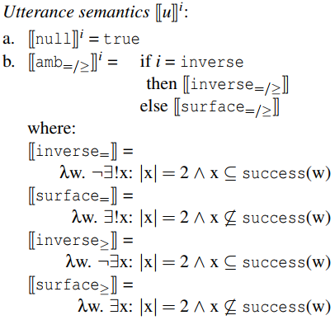

Slide 62
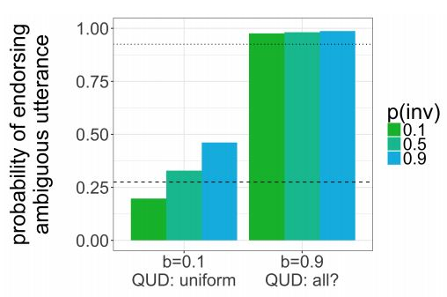
Current Results
Without contrast: 27.5%
With contrast: 92.5%

Slide 63
Current Results
Without contrast: 27.5%
With contrast: 92.5%
- Again, the pragmatic factors are more likely to yield the observed behavior

Slide 64
Current Results
Without contrast: 27.5%
With contrast: 92.5%
- Informativity again matters for capturing the explicit contrast effects with adults

Slide 65
Two relevant effects here:
Adult sensitivity to the explicit contrast manipulation in the 2-frog context (jump from 27.5% endorsement to 92.5% endorsement)
2-frog vs 4-frog endorsement difference in adults (27.5% and 100%)

Slide 66
Two relevant effects here:
Adult sensitivity to the explicit contrast manipulation in the 2-frog context (jump from 27.5% endorsement to 92.5% endorsement)
2-frog vs 4-frog endorsement difference in adults (27.5% and 100%)
We need to address ‘2’

Slide 68
‘exact’
Inverse = True
Surface = False

Slide 69
‘at-least’
Inverse = True
Surface = True

Slide 70
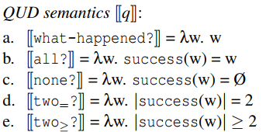

Slide 71
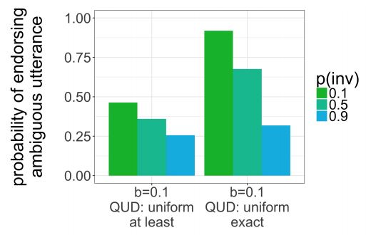
Current Results
2-Frog: 27.5%
4-Frog: 100%
Baserate = .1
QUD = uniform
4-Frog

Slide 72
Current Results
2-Frog: 27.5%
4-Frog: 100%
Baserate = .1
QUD = uniform
2-Frog
4-Frog

Slide 73
Current Results
2-Frog: 27.5%
4-Frog: 100%
Baserate = .1
QUD = uniform
‘exact’
Inverse = .1
2-Frog
4-Frog

Slide 74
Results - Summary
The model captures the explicit contrast with both pragmatic manipulations and processing manipulations, but pragmatic manipulations impact endorsement more
Model can capture the 2-frog and 4-frog asymmetry with an exact semantics for ‘two’

Slide 75
Results - Summary
The model captures the explicit contrast with both pragmatic manipulations and processing manipulations, but pragmatic manipulations impact endorsement more
Model can capture the 2-frog and 4-frog asymmetry with an exact semantics for ‘two’

Slide 76
Discussion
Evidence from computational-level modeling for developmental continuity in children’s development of, specifically, their scope disambiguation mechanism.
Computational leveling modeling allows for a rigorous manipulation of the relevant factors that might not be possible in an experimental setting (example: manipulation of how ‘two’ is interpreted)

Slide 77
Discussion
Evidence from computational-level modeling for developmental continuity in children’s development of, specifically, their scope disambiguation mechanism.
Evidence for two being interpreted as ‘exactly two’ at the utterance level for the “two-not” utterance.
Computational leveling modeling allows for a rigorous manipulation of the relevant factors that might not be possible in an experimental setting (example: manipulation of how ‘two’ is interpreted)

Slide 78
Discussion
Evidence from computational-level modeling for developmental continuity in children’s development of, specifically, their scope disambiguation mechanism.
Evidence for two being interpreted as ‘exactly two’ at the utterance level for the “two-not” utterance.
Computational leveling modeling allows for a rigorous manipulation of the relevant factors that might not be possible in an experimental setting (example: manipulation of how ‘two’ is interpreted)
Computational level modeling allows for a rigorous manipulation of the relevant factors that might not be possible in an experimental setting

Slide 79
Future Work
Mechanical Turk experiment to test the models predictions
- Replicate Musolino and Lidz (2003)
Should be able to independently manipulate QUD and world state variables on Mturk.

Slide 80
Thank You!
Thanks to Greg Scontras and Lisa Pearl!
Thanks to the CoLalab for feedback!

Slide 81
Scope Ambiguity
Multiple theories:
Pragmatic factors:
- The contrast manipulations changed
Processing factors: It’s difficult to get to the inverse interpretation

Slide 82
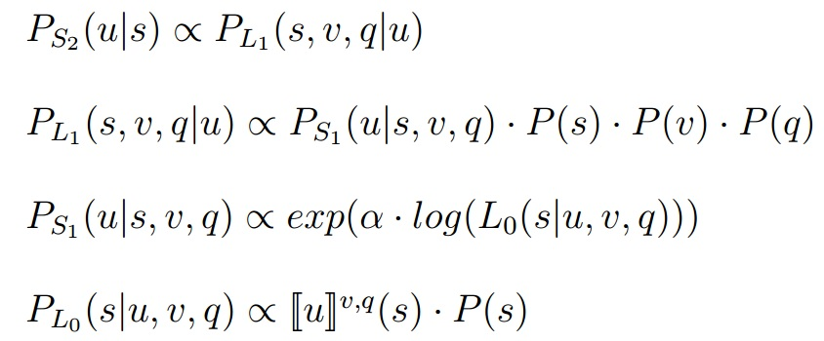
The Model
Invert a pragmatic listener, who has uncertainty about the relevant factors (pragmatic and processing), to calculate an endorsement probability
(Savinelli, Scontras & Pearl, 2017)

